Slide 1

Parallel algorithms for the analysis and synthesis of data
Andriushchenko Petr, PhD

Slide 2
OpenMP

Slide 3
num_threads()
if()
shared()
#pragma omp parallel
private()
firstprivate()
lastprivate()
reduction()

Slide 4
private()
firstprivate()
#pragma omp single
#pragma omp master
Copyprivate()
nowait()

Slide 5
private()
firstprivate()
lastprivate()
reduction()
#pragma omp for
schedule()
collapse()
ordered()
nowait()

Slide 6













#pragma omp for
nowait()
i=0
i=100
i=200
i=99
i=299
i=199

Slide 7
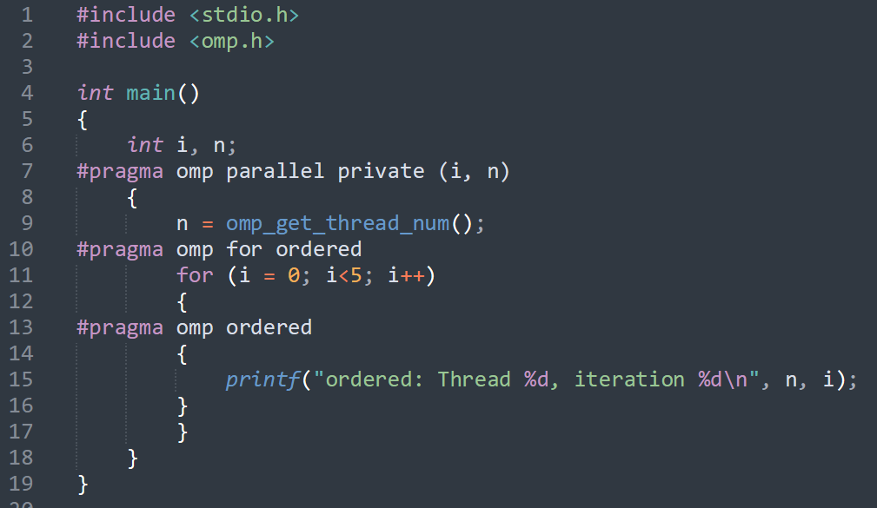
#pragma omp for
ordered()

Slide 8
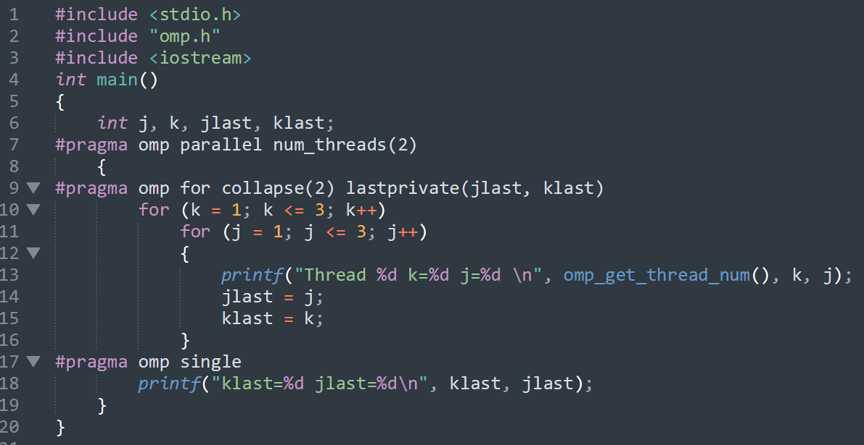



#pragma omp for
collapse()

Slide 9
#pragma omp for
schedule()
(static,10)
(dynamic,10)
(guided,10)
(auto)
(runtime)

Slide 10
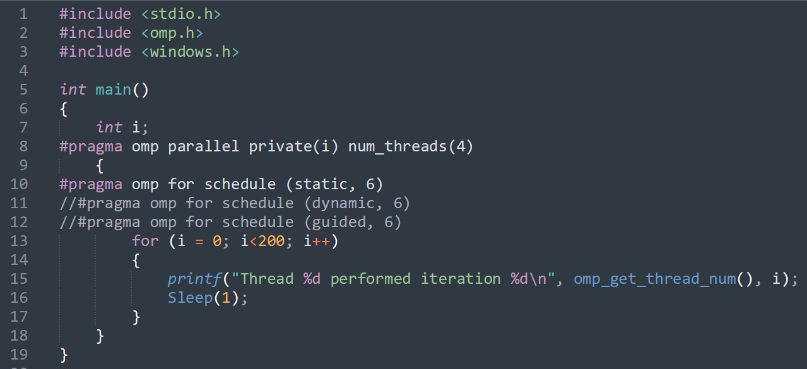
#pragma omp for
schedule()

Slide 11
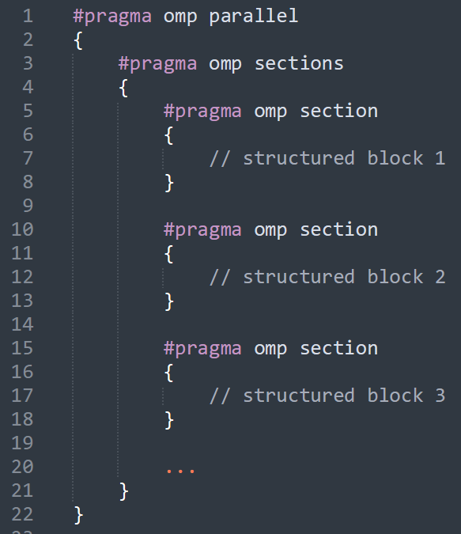




#pragma omp
sections()
manual parallelization control

Slide 12
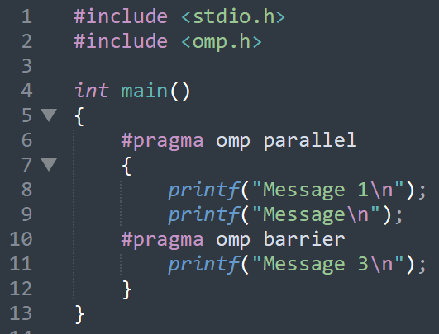
Synchronization
#pragma omp
barrier()

Slide 13
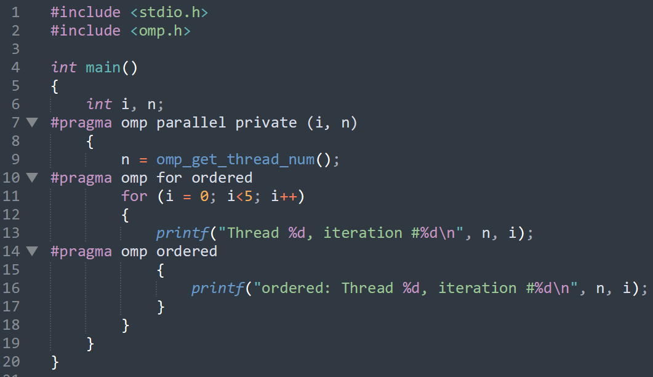
Synchronization
#pragma omp
ordered()

Slide 14











Synchronization
#pragma omp
ordered()

Slide 15
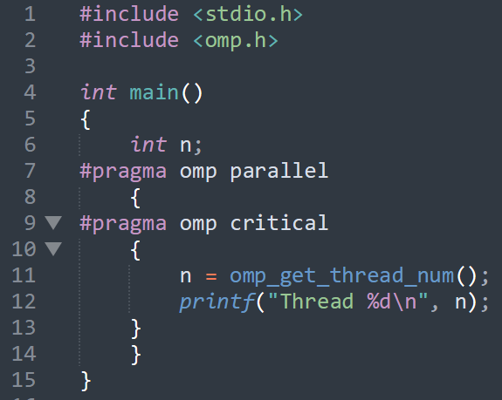

















Synchronization
#pragma omp
critical(name)

Slide 16
Synchronization
#pragma omp
atomic
Updating shared variables

Slide 17
Synchronization
simple
nested
lock
omp_init_lock
initialization
omp_init_nest_lock
uninitialization
omp_destroy_lock
omp_destroy_nest_lock
wait until free and block
omp_set_lock
omp_set_nest_lock
omp_unset_lock
unblock
omp_unset_nest_lock
omp_test_lock
check if free
omp_test_nest_lock

Slide 18
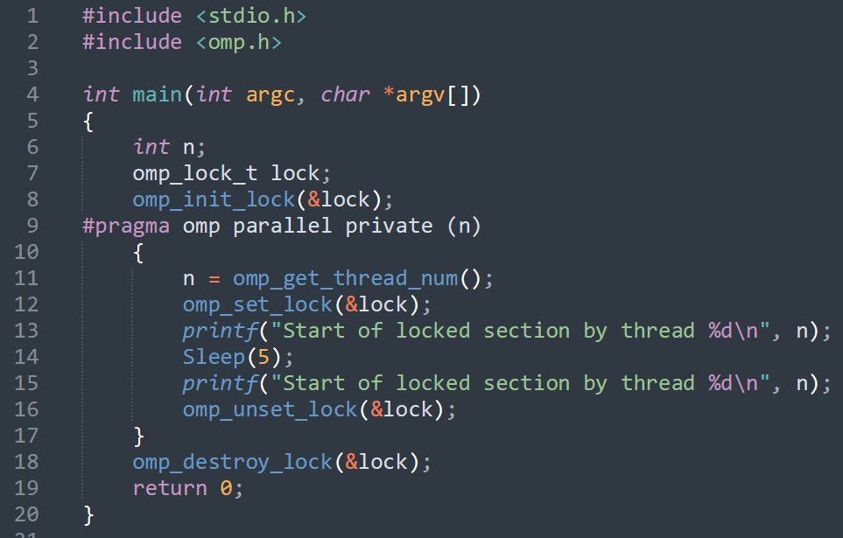









Synchronization
lock

Slide 19
MPI

Slide 20
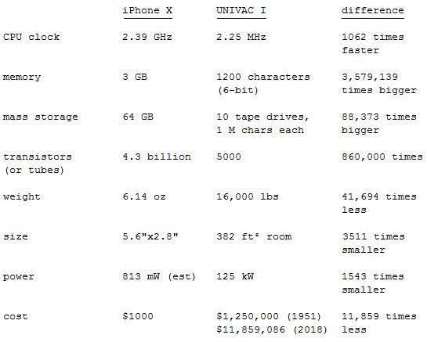


MPI
flops
600
500
FLoating-point Operations Per Second

Slide 21
MPI
flops
600 *10^9
500
FLoating-point Operations Per Second

Slide 22
MPI
flops
600 000 000 000
500
FLoating-point Operations Per Second

Slide 23
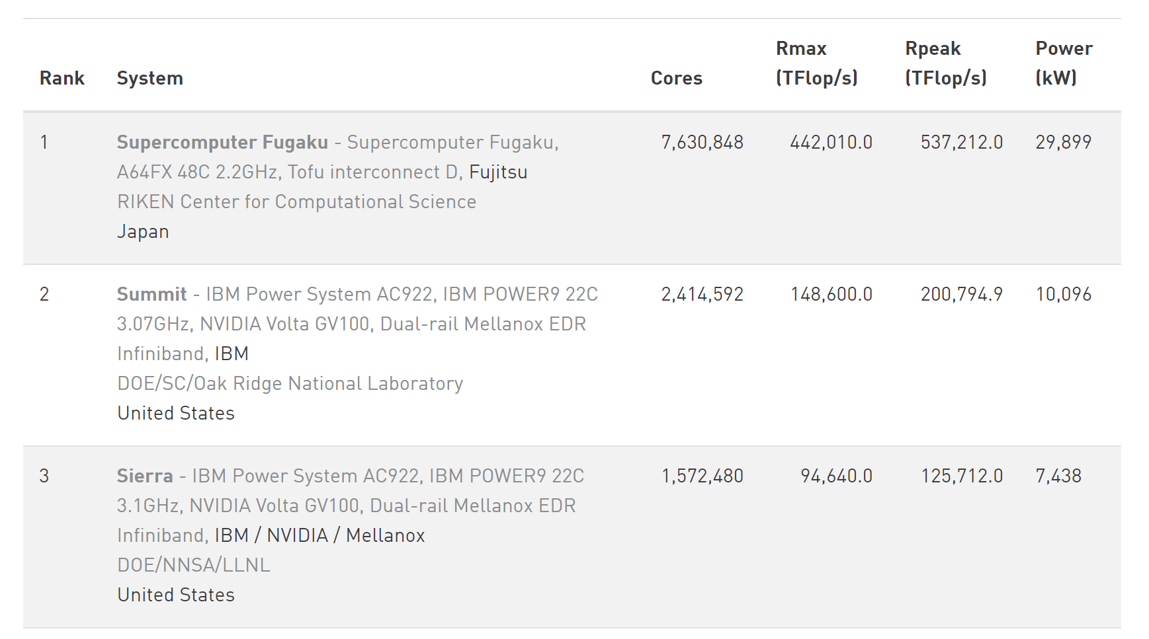
MPI
442 010 TFlop/s = 442 PFlop/s = 0.5 EFlops/s
442 010 000 000 000 000 000 Flops/s
FLoating-point Operations Per Second
https://www.top500.org/lists/top500/2021/11/

Slide 24
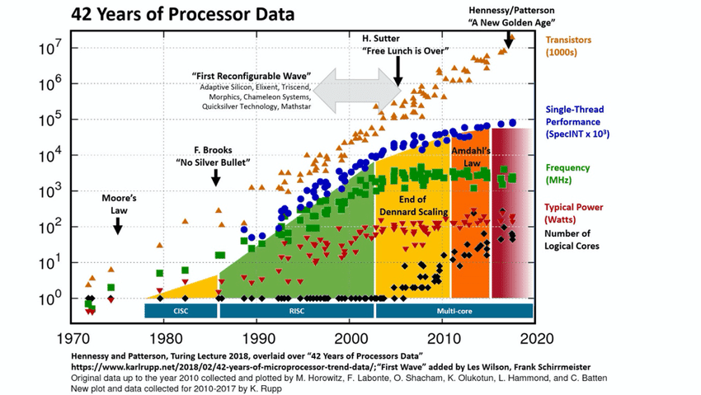
MPI

Slide 25
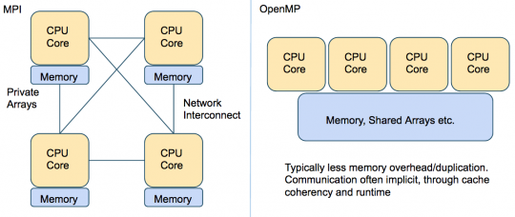
MPI
Distributed memory
Shared memory
MPI (Message Passing Interface) is a standardized and portable message-passing standard designed to function on parallel computing architectures.
OpenMP (Open Multi-Processing) is an application programming interface (API) that supports multi-platform shared-memory multiprocessing programming.

Slide 26
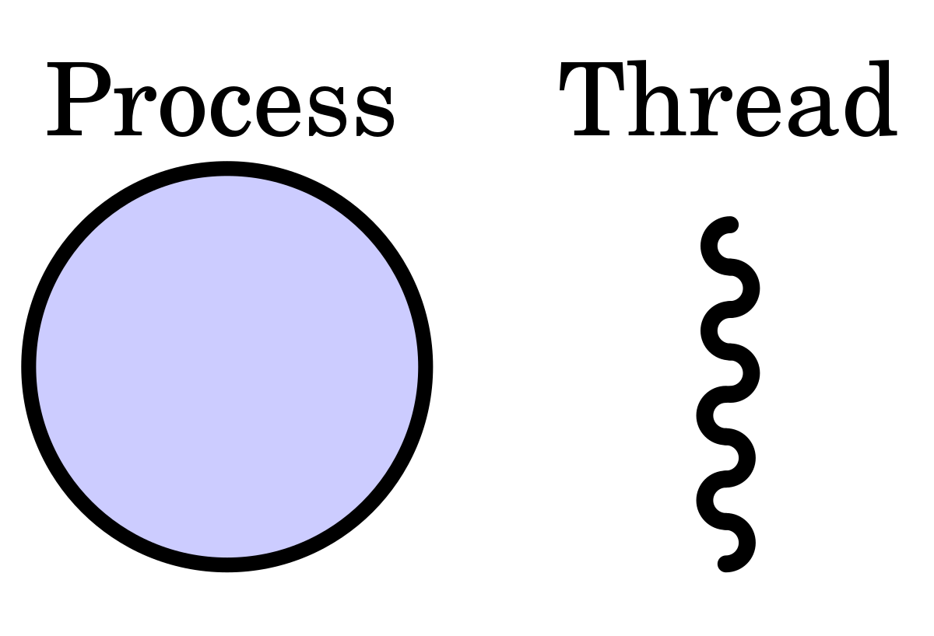
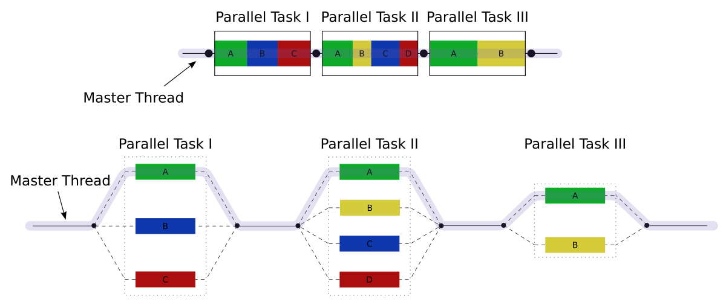

MPI
Shared memory

Slide 27
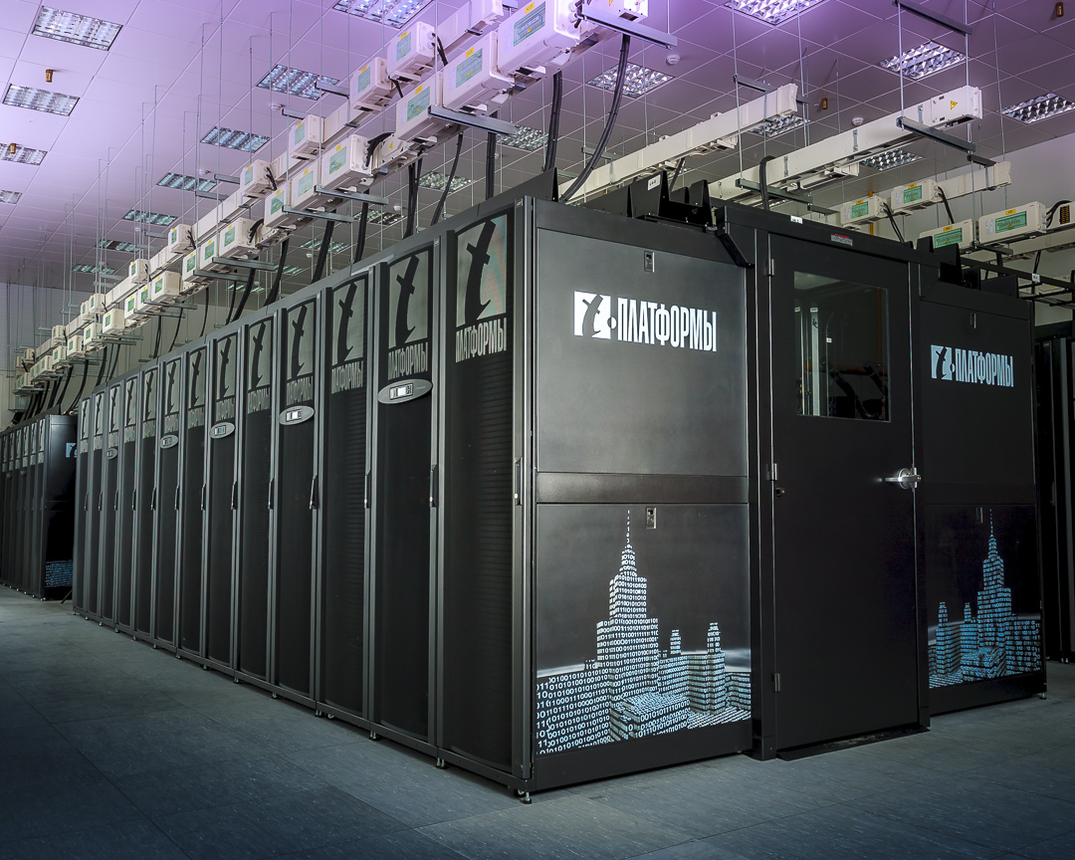
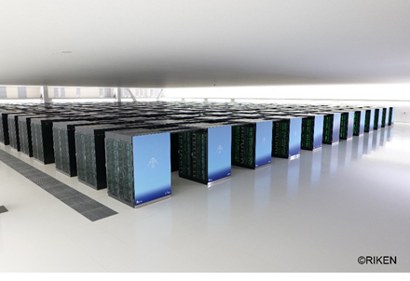
MPI
Distributed memory
MPI (Message Passing Interface) is a standardized and portable message-passing standard designed to function on parallel computing architectures.
7,630,848 cores

Slide 28




MPI
How they communicate?
7,630,848 cores

Slide 29


MPI
Each manufacturer used its own messaging system that was incompatible with the others.
1992 – Discussions began on the standardization of the messaging protocol.
MPI Forum approved the final MPI 1.0 standard
https://www.mpi-forum.org/
Application independence
from computer architecture.

Slide 30
MPI
MPI
The MPI standard includes point-to-point message-passing, collective communications, group and communicator concepts, process topologies, environmental management, process creation and management, one-sided communications, extended collective operations, external interfaces, I/O, some miscellaneous topics, and multiple tool interfaces. Language bindings for C and Fortran are defined.

Slide 31
MPI
Realizations:
MPICH from Argonne National Laboratory
LAM/MPI from Ohio Supercomputer Center
Open MPI (not to be confused with OpenMP) was formed by the merging FT-MPI, LA-MPI, LAM/MPI, and PACX-MPI
MESH-MPI from MESH-Technologies
IBM MPI
Intel MPI
…

Slide 32
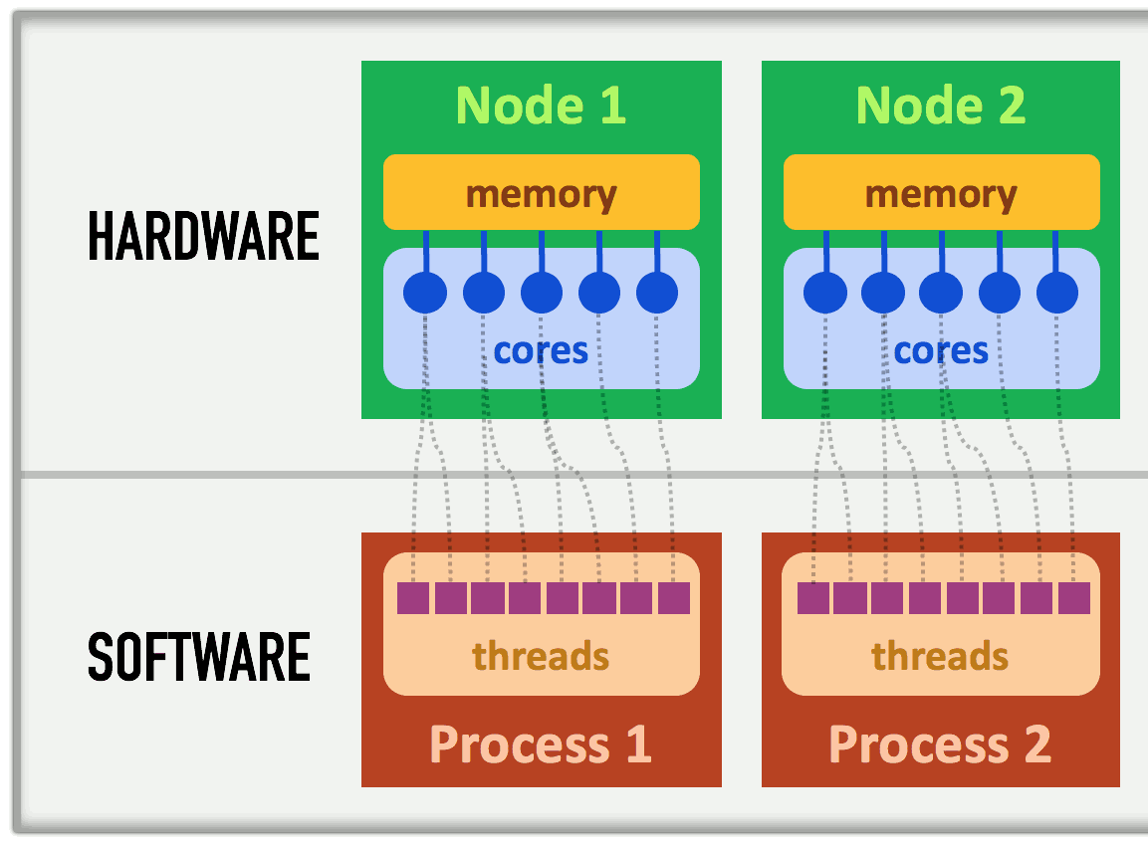
MPI

Slide 33
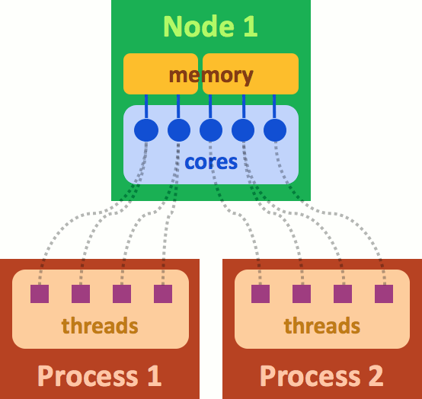
MPI

Slide 34
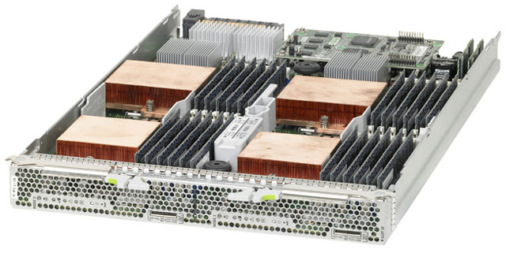
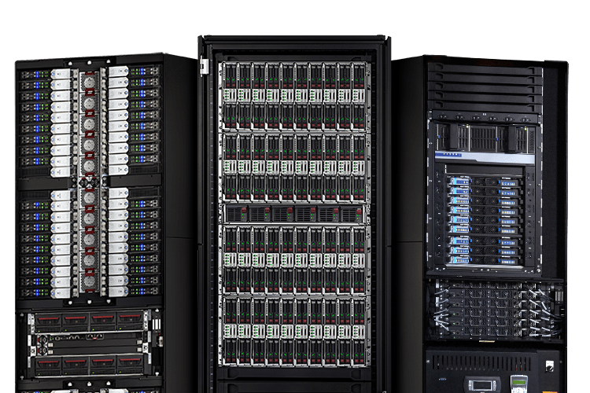
MPI

Slide 35
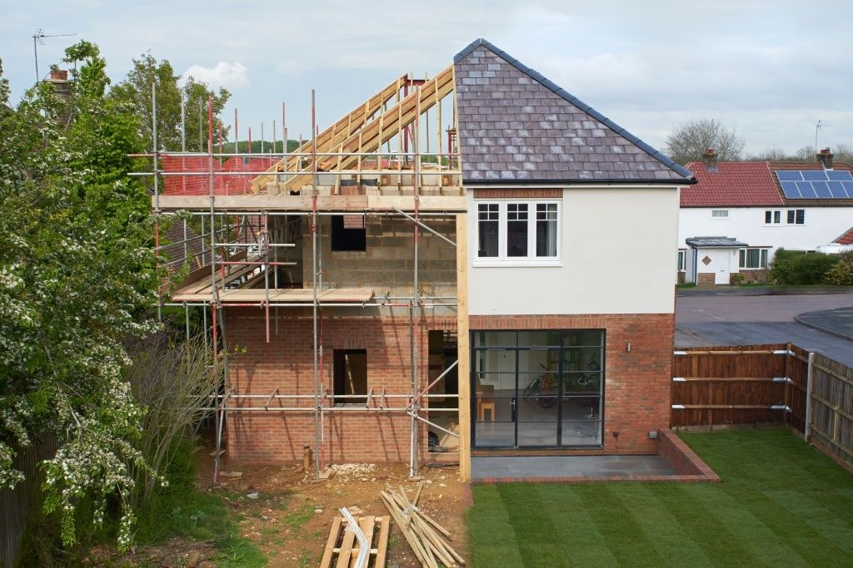
MPI
The task is to build a house

Slide 36

MPI
The task is to build a house

Slide 37
MPI
The task is to build a house

Slide 38
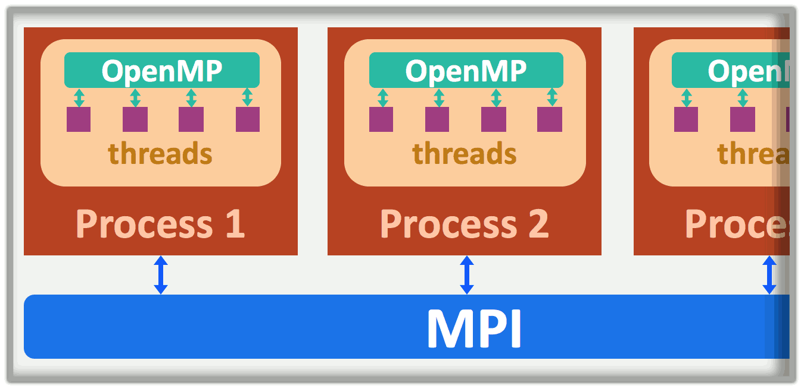
MPI

Slide 39
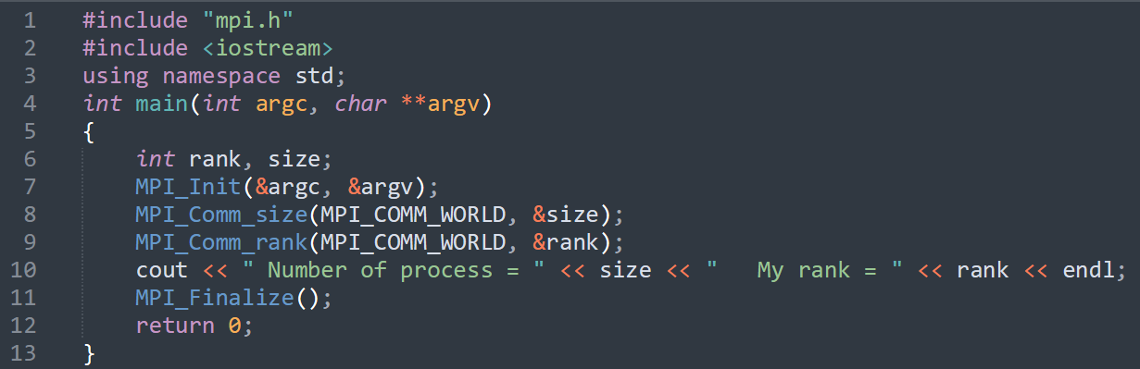
MPI
First program:
#include “mpi.h”

Slide 40
MPI
First program:
#include “mpi.h”
MPI_

Slide 41


MPI
First program:
#include “mpi.h”
Initialization
MPI_Init(&argc,&argv)

Slide 42

MPI
First program:
Initialization
MPI_Init(&argc,&argv)
A communicator is an object describing a group of processes.
MPI Communicator
MPI_COMM_WORLD

Slide 43

MPI
MPI_COMM_WORLD

Slide 44


MPI
MPI_COMM_WORLD

Slide 45





MPI
First program:
total number of processes
MPI_Comm_size(,)
MPI_Comm_rank(,)
each process number

Slide 46
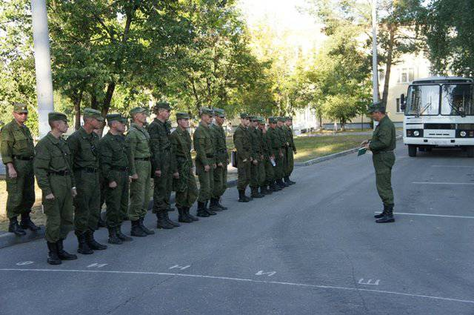



MPI
First program:
roll call
total number of processes
MPI_Comm_size(,)
MPI_Comm_rank(,)
each process number

Slide 47


MPI
First program:
MPI_Finalize()
End of parallel part of the program

Slide 48
MPI
Message
-Data
-Service information

Slide 49

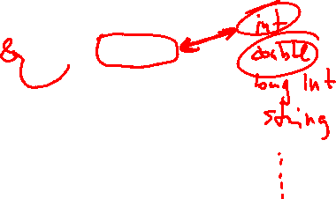

MPI
Message
-Data
$[a_{00},a_{01}$, $a_{02}$, $a_{10}$, $a_{11}$, $a_{12}$, $a_{20}$, $a_{21}$, $a_{22}]$
-address of first element
-number of transferred elements
-type of transferred elements
a[00], 3,MPI_INT

Slide 50



Basic MPI Point-to-Point Communication
int MPI_Send
(void* buf,
int count,
MPI_Datatype datatype,
int dest,
int tag,
MPI_Comm comm)
the address of the beginning of the transferred data location;
the number of elements sent;
the type of elements sent;
is the number of the receiving process (in communicator comm);
message identifier (name);
communicator.
Point-to-Point Communication

Slide 51
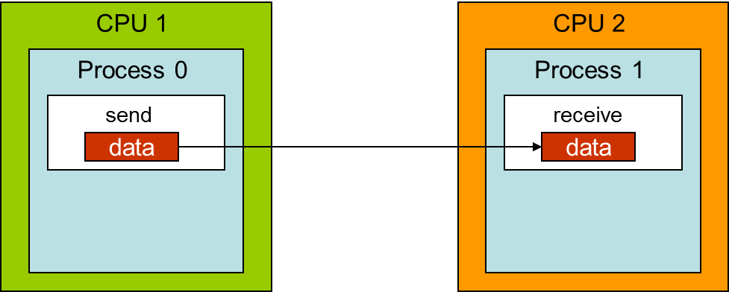
Basic MPI Point-to-Point Communication
int MPI_Send
(void* buf,
int count,
MPI_Datatype datatype,
int dest,
int tag,
MPI_Comm comm)
the address of the beginning of the transferred data location;
the number of elements sent;
the type of elements sent;
is the number of the receiving process (in communicator comm);
message identifier (name);
communicator.

Slide 52

Basic MPI Point-to-Point Communication
int MPI_Send
(void* buf,
int count,
MPI_Datatype datatype,
int dest,
int tag,
MPI_Comm comm)
the address of the beginning of the transferred data location;
the number of elements sent;
the type of elements sent;
is the number of the receiving process (in communicator comm);
message identifier (name);
communicator.
Example
int MPI_Send (&a[0], 3, MPI_Int, 1, 1, MPI_Comm_world)

Slide 53
Basic MPI Point-to-Point Communication
int MPI_Recv(
void* buf,
int count,
MPI_Datatype datatype,
int source,
int tag,
MPI_Comm comm, MPI_Status *status)
the address of the beginning of the recived data location;
the number of elements recive;
the type of elements;
is the number of the sending process (in communicator comm);
message identifier (name);
communicator;
message attributes
Example
int MPI_Recv (&b[0], 3, MPI_Int, 1, 1, MPI_Comm_world,&status)

Slide 54
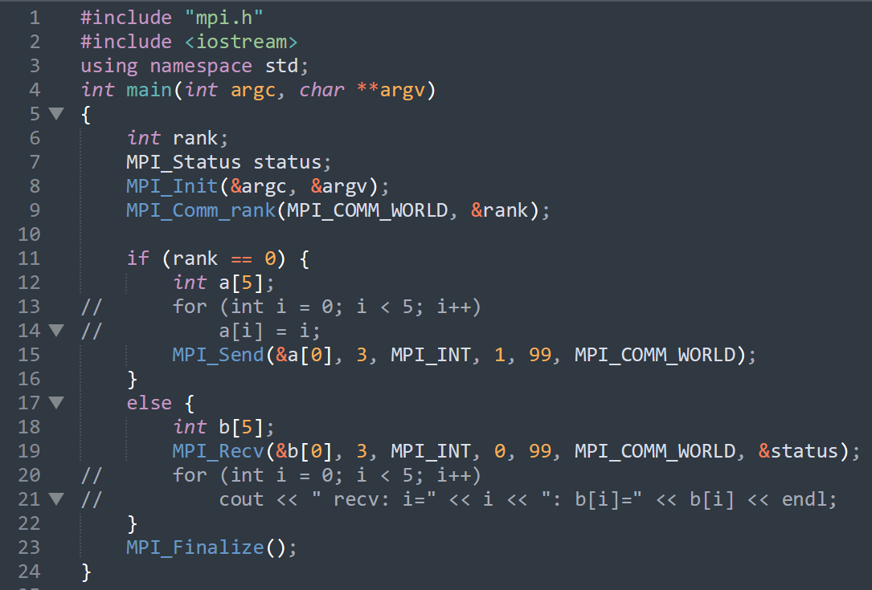










Basic MPI Point-to-Point Communication

Slide 55
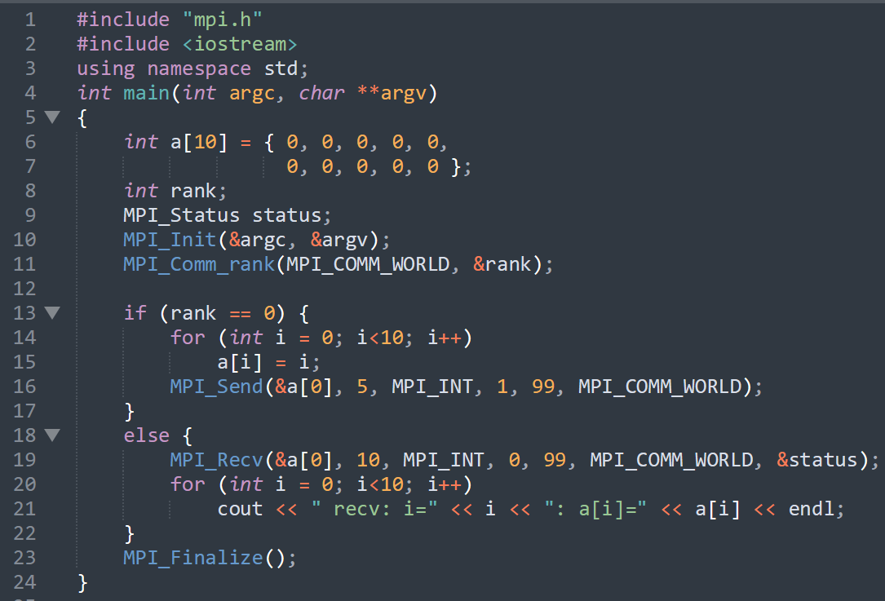






Basic MPI Point-to-Point Communication

Slide 56


Blocking operations
You tidying up the garage
Your friend

Slide 57


Blocking operations
You tidying up the garage
Your friend
Point-to-Point Communication

Slide 58



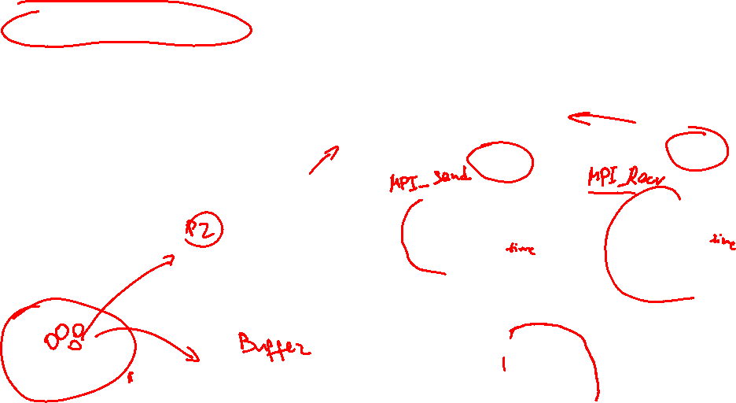
Blocking operations
MPI_Send standard regime (independent start- auto stop)
MPI_Bsend buffered regime (independent start- independent stop)
MPI_Ssend synchronous regime (independent start- depended stop)
MPI_Rsend ready regime (depended start- independent stop)

Slide 59


Blocking operations
if(rank==0)
{
MPI_Recv(&rbuf,count,MPI_INT,1,2,MPI_COMM_WORLD,&status);
MPI_Send(&rbuf,count,MPI_INT,1,2,MPI_COMM_WORLD);
}
if(rank==1)
{
MPI_Recv(&rbuf,count,MPI_INT,1,2,MPI_COMM_WORLD,&status);
MPI_Send(&rbuf,count,MPI_INT,1,2,MPI_COMM_WORLD);
}
0
1
MPI_Recv
MPI_Send
MPI_Recv
MPI_Send

Slide 60

Blocking operations
if(rank==0)
{
MPI_Recv(&rbuf,count,MPI_INT,1,2,MPI_COMM_WORLD,&status);
MPI_Send(&rbuf,count,MPI_INT,1,2,MPI_COMM_WORLD);
}
if(rank==1)
{
MPI_Recv(&rbuf,count,MPI_INT,1,2,MPI_COMM_WORLD,&status);
MPI_Send(&rbuf,count,MPI_INT,1,2,MPI_COMM_WORLD);
}
0
1
DEADLOCK
MPI_Recv
MPI_Send
MPI_Recv
MPI_Send

Slide 61

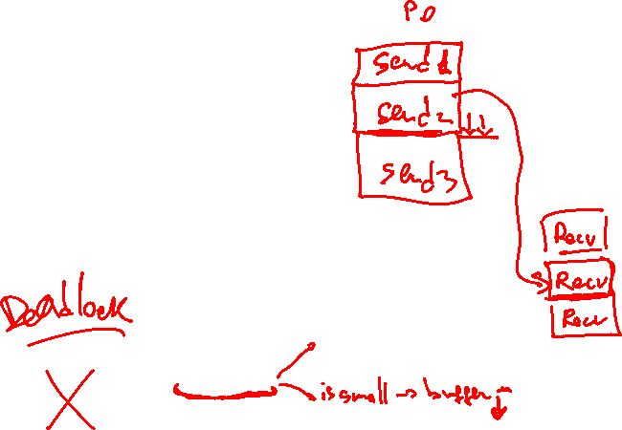
Blocking operations
if(rank==0)
{
MPI_Send(&rbuf,count,MPI_INT,1,2,MPI_COMM_WORLD);
MPI_Recv(&rbuf,count,MPI_INT,1,1,MPI_COMM_WORLD,&status);
}
if(rank==1)
{
MPI_Send(&rbuf,count,MPI_INT,0,1,MPI_COMM_WORLD);
MPI_Recv(&rbuf,count,MPI_INT,0,2,MPI_COMM_WORLD,&status);
}
0
1
MPI_Send
MPI_Recv
MPI_Send
MPI_Recv

Slide 62

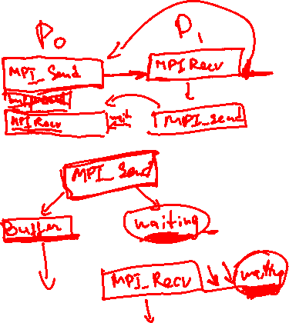

Blocking operations
if(rank==0)
{
MPI_Send(&rbuf,count,MPI_INT,1,2,MPI_COMM_WORLD);
MPI_Recv(&rbuf,count,MPI_INT,1,2,MPI_COMM_WORLD,&status);
}
if(rank==1)
{
MPI_Recv(&rbuf,count,MPI_INT,1,2,MPI_COMM_WORLD,&status);
MPI_Send(&rbuf,count,MPI_INT,1,2,MPI_COMM_WORLD);
}
0
1
MPI_Send
MPI_Recv
MPI_Recv
MPI_Send

Slide 63
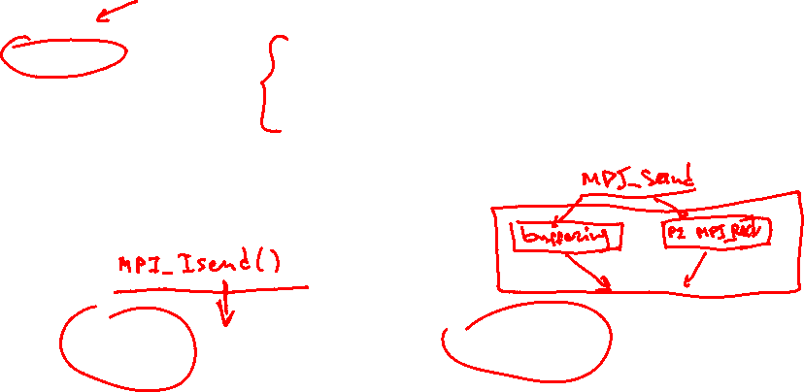
Non-Blocking operations
int MPI_Isend(
void* buf,
int count,
MPI_Datatype datatype,
int dest,
int tag,
MPI_Comm comm,
MPI_Request *request
)
the address of the beginning of the transferred data location;
the number of elements sent;
the type of elements sent;
is the number of the receiving process (in communicator comm);
message identifier (name);
communicator.
request identificator
MPI_Test()
MPI_Wait()

Slide 64
Non-Blocking operations
MPI_Isend standard regime
MPI_Ibsend buffered regime
MPI_Issend synchronous regime
MPI_Irsend ready regime
https://iamsorush.com/posts/mpi-send-types/

Slide 65
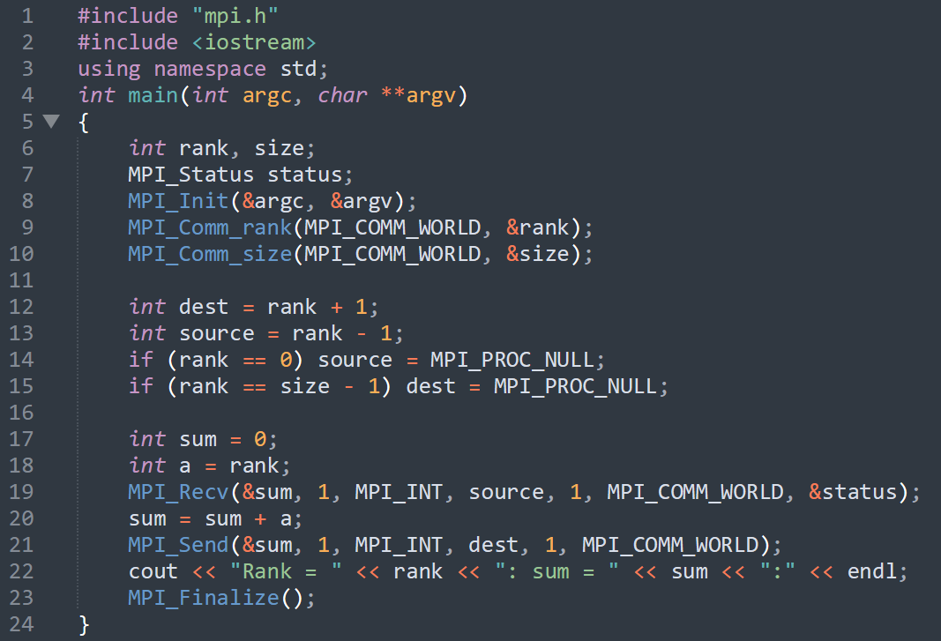
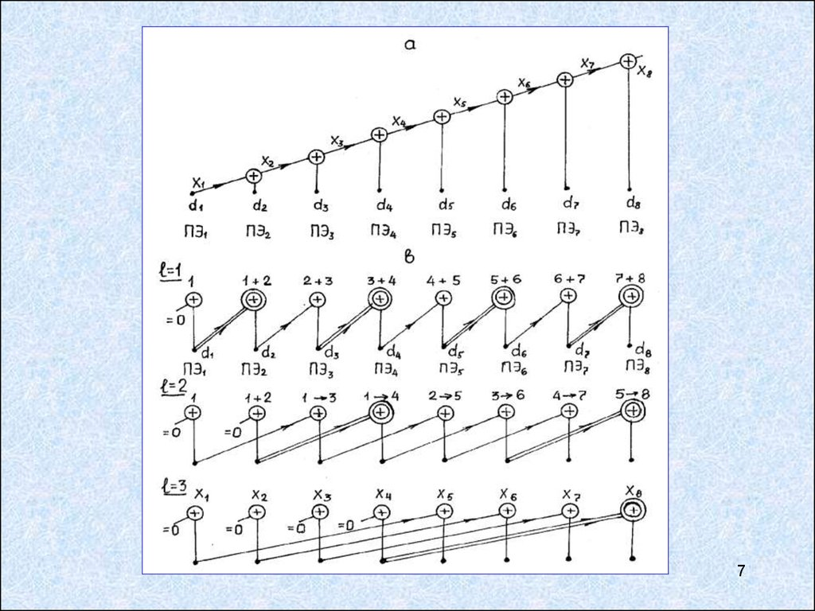
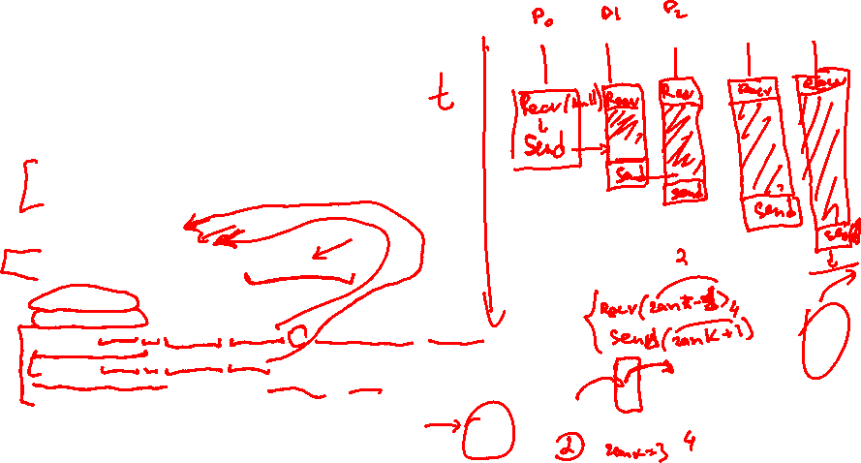
Parallel summation algorithms
P-1

Slide 66
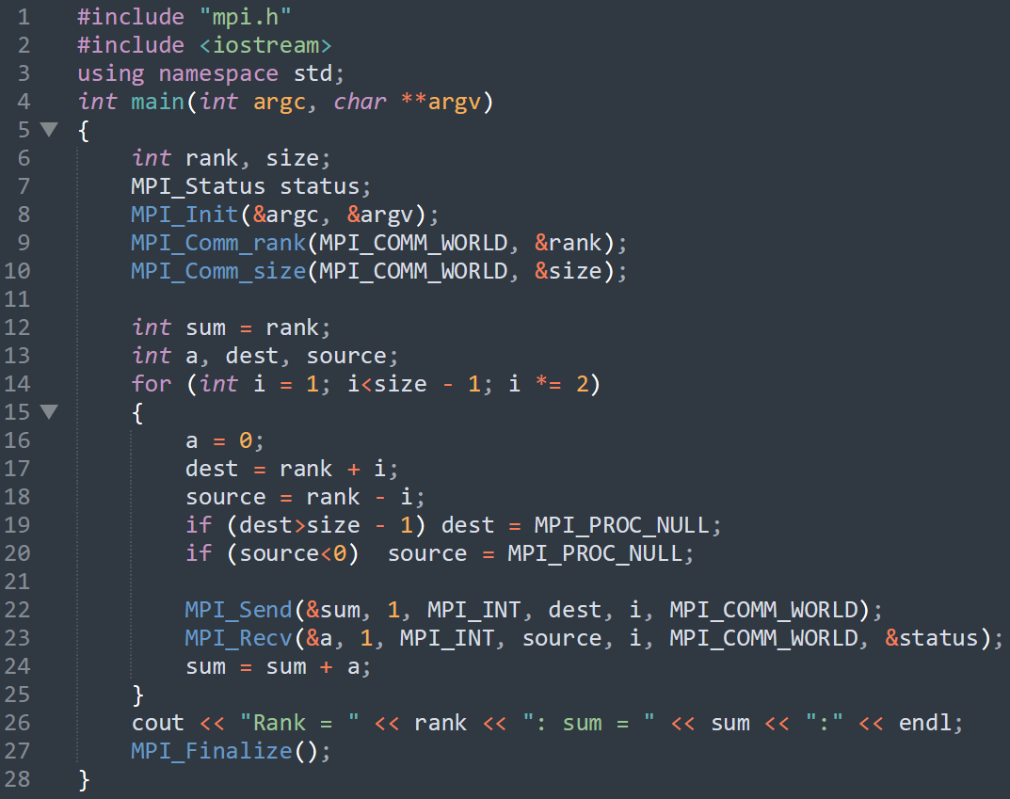
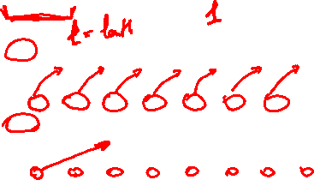
Parallel summation algorithms
Log_2 P

Slide 67
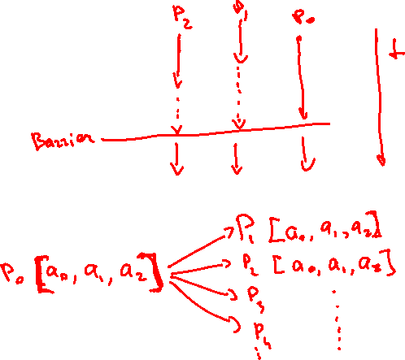
Collective operations
MPI_Barrier()
MPI_Bcast()

Slide 68
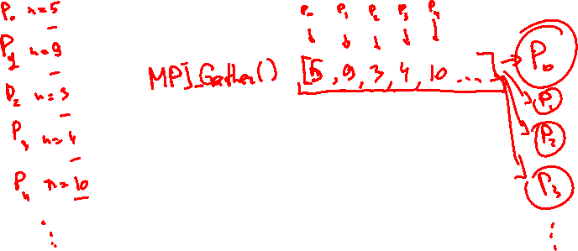
Collective operations
MPI_Gather()
MPI_Allgather()

Slide 69
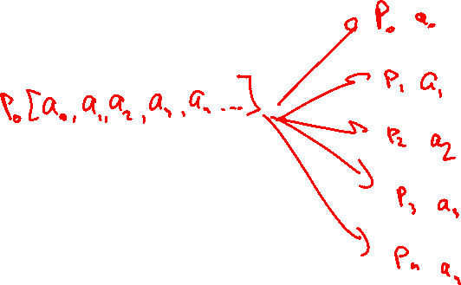
Collective operations
MPI_Scatter()

